Slide 1




NEXT GEN EMPLOYABILITY PROGRAM
Creating a future-ready workforce
Team Members
College Name
Student Name :Nandhini I
Student ID : au960221104077
Arunachala College of Engineering for Women

Slide 2

CAPSTONE PROJECT SHOWCASE
Project Title
Car Rentals Application with Django Framework
Abstract | Problem Statement | Project Overview | Proposed Solution | Technology Used | Modelling & Results | Conclusion

Slide 3
Abstract
The Car Rentals Application, built with Django, simplifies the vehicle rental process for customers and provides powerful management tools for rental companies. Customers can easily browse and book cars, while administrators can efficiently manage inventory, bookings, and generate reports. The system ensures data security and scalability, with potential for future enhancements like payment integration and advanced analytics.
Source :

Slide 4
Problem Statement
The traditional car rental process is inefficient and cumbersome for both customers and rental companies. Customers struggle to find available vehicles and manage bookings, while rental companies face challenges in inventory management and administrative tasks. To address these issues, we propose developing a Car Rentals Application with Django. This application will simplify booking for customers and automate administrative tasks for rental companies, ensuring data security, scalability, and potential for future enhancements like payment integration and analytics
Source :

Slide 5
Project Overview
Here is the overview for the project:
Planning and Requirements Gathering: Begin by defining project objectives and gathering requirements for the car rental website.
Designing User Interface: Design the frontend of the website using HTML, CSS, and JavaScript to create an intuitive and visually appealing user interface.
Backend Development with Django: Set up the backend infrastructure using Django, a high-level Python web framework. Develop models for cars, users, bookings, and other relevant entities, along with appropriate database schema.
Admin Panel Development: Create an admin panel using Django's admin interface or custom admin views to enable administrators to manage cars, bookings, users, and other aspects of the system efficiently.
Source :

Slide 6
Proposed Solution
.
Our solution entails building a comprehensive Car Rentals Application using the Django framework, aimed at revolutionizing the car rental experience for both customers and rental companies.
For customers, the application will provide a seamless booking process through an intuitive interface. They can easily browse available vehicles, view detailed information including pricing and specifications, and make bookings with minimal effort. Advanced search and filtering options will enhance the user experience, ensuring customers can quickly find the perfect vehicle for their needs.
Source :

Slide 7
On the rental company side, the application will offer robust management tools to streamline operations. Rental companies can efficiently manage their vehicle inventory, track bookings, set dynamic pricing based on demand and other factors, and generate detailed reports for analysis. Automation of administrative tasks will save time and reduce errors, improving overall efficiency.
Key features of the proposed solution include:
1.User-friendly interface: Designing an intuitive and responsive interface for customers to browse and book vehicles effortlessly.
2.Advanced search and filtering: Implementing powerful search and filtering options to help customers find the ideal vehicle quickly.
3.Dynamic pricing: Allowing rental companies to set flexible pricing based on factors such as demand, seasonality, and vehicle type.
Source :

Slide 8
4.Inventory management: Providing tools for rental companies to easily add, edit, and remove vehicles from their inventory, along with detailed vehicle information.
5.Booking management: Enabling rental companies to track bookings, manage reservations, and handle cancellations efficiently.
6.Reporting and analytics: Generating insightful reports for rental companies to analyze rental activity, revenue, and other key metrics, aiding in strategic decision-making.
7.Security and scalability: Implementing robust security measures to protect user data and ensuring the application is scalable to accommodate future growth and feature enhancements.
Source :

Slide 9


Technology Used
Front-end
Back-end
Source :

Slide 10
Modelling & Results
To create a car rental system using frontend tools like HTML, CSS, and JavaScript, combined with backend tools like Python and Django, you can follow these steps: Design the User Interface (UI): Use HTML to structure the web pages, including forms for user input. Apply CSS for styling to make the interface visually appealing and user-friendly. Utilize JavaScript for client-side interactivity, such as form validation and dynamic content updates. Backend Development with Django: Set up a Django project and create Django apps for different functionalities (e.g., user authentication, car rental management). Define models for storing data related to users, cars, reservations, etc. Implement views to handle user requests and interact with data through Django's ORM. Configure URLs to map requests to appropriate views.
Source :

Slide 11
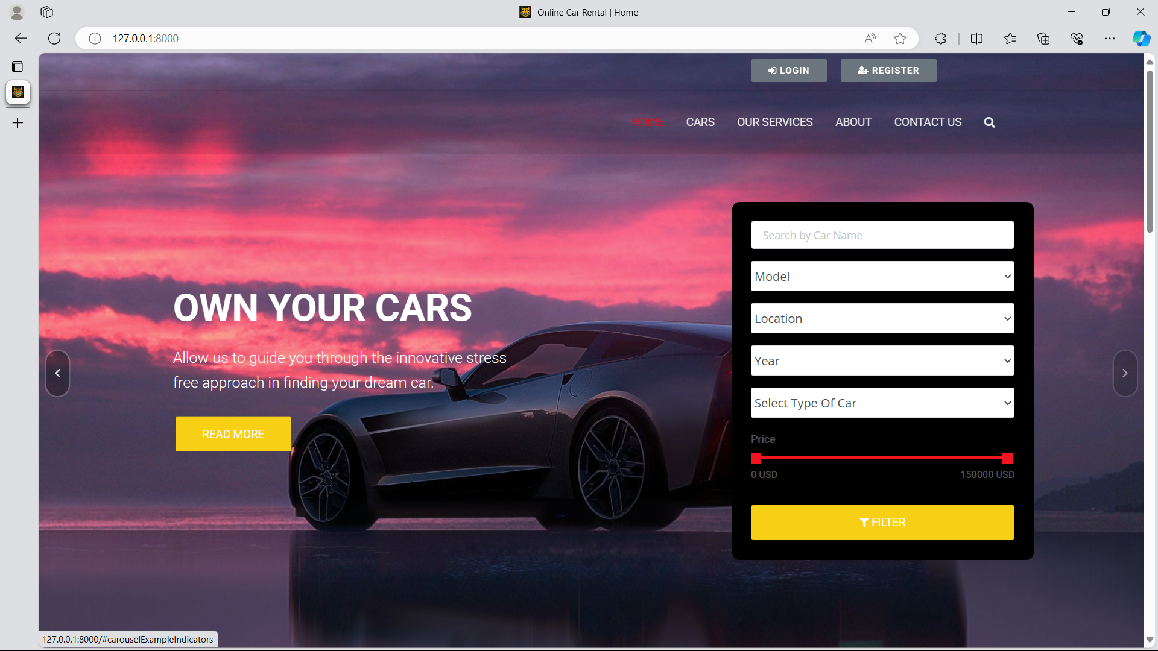
Homepage

Slide 12
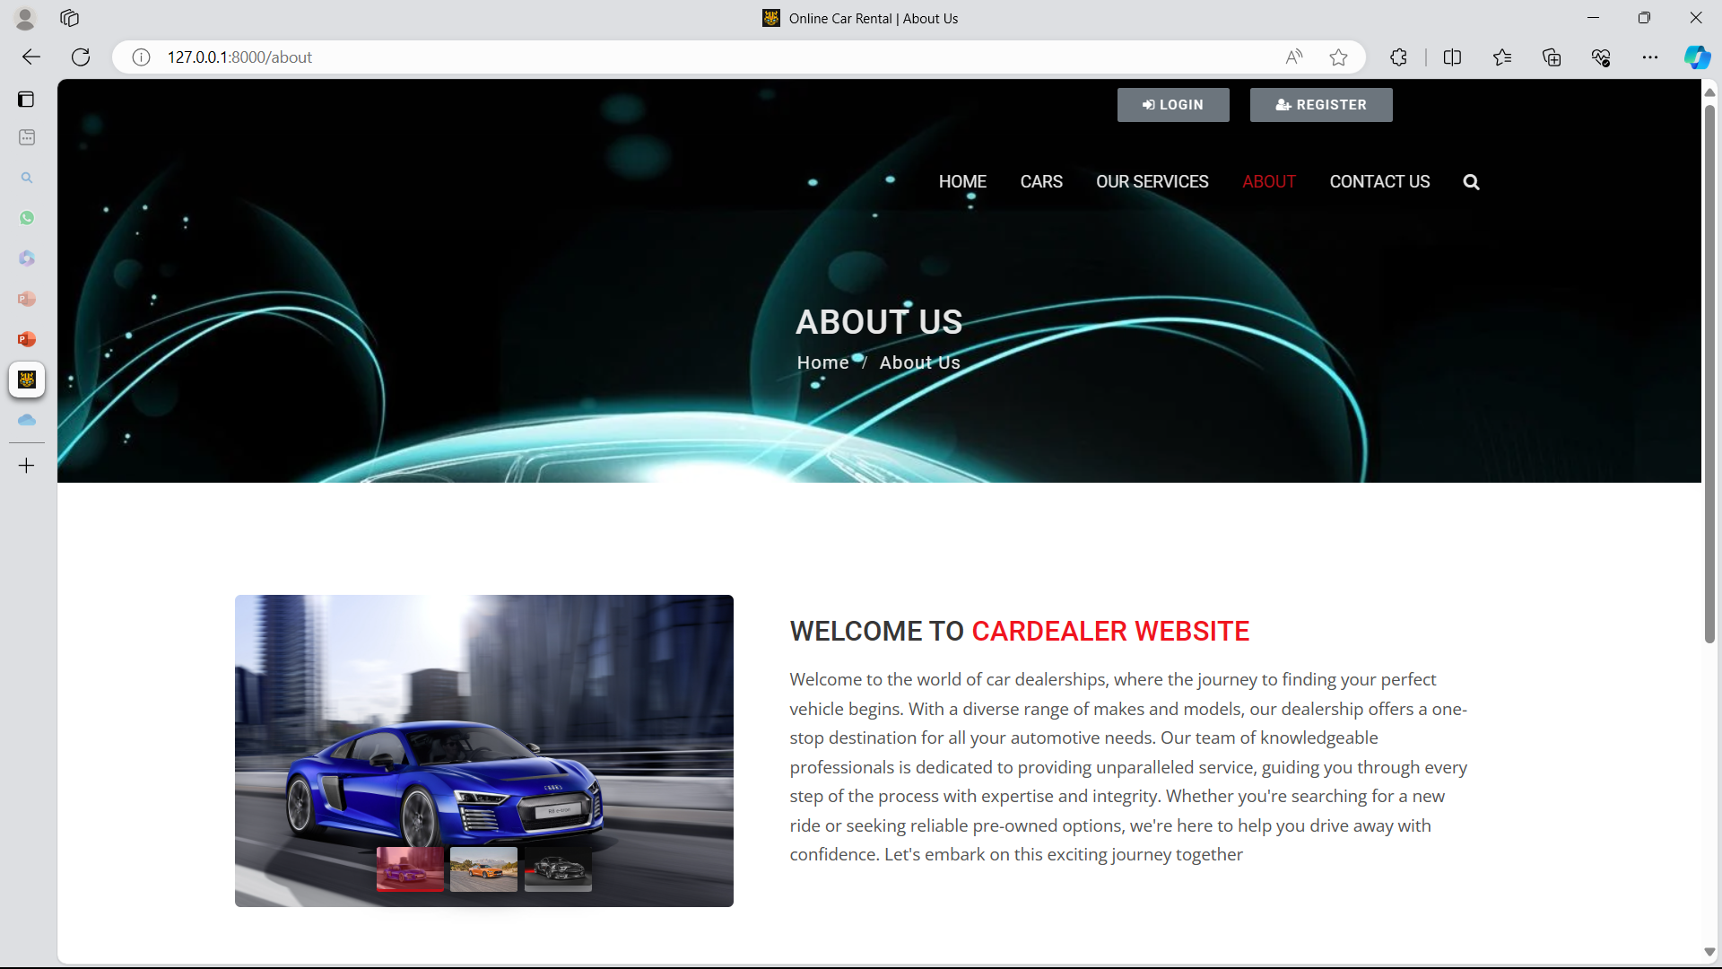
About-Us-Page

Slide 13
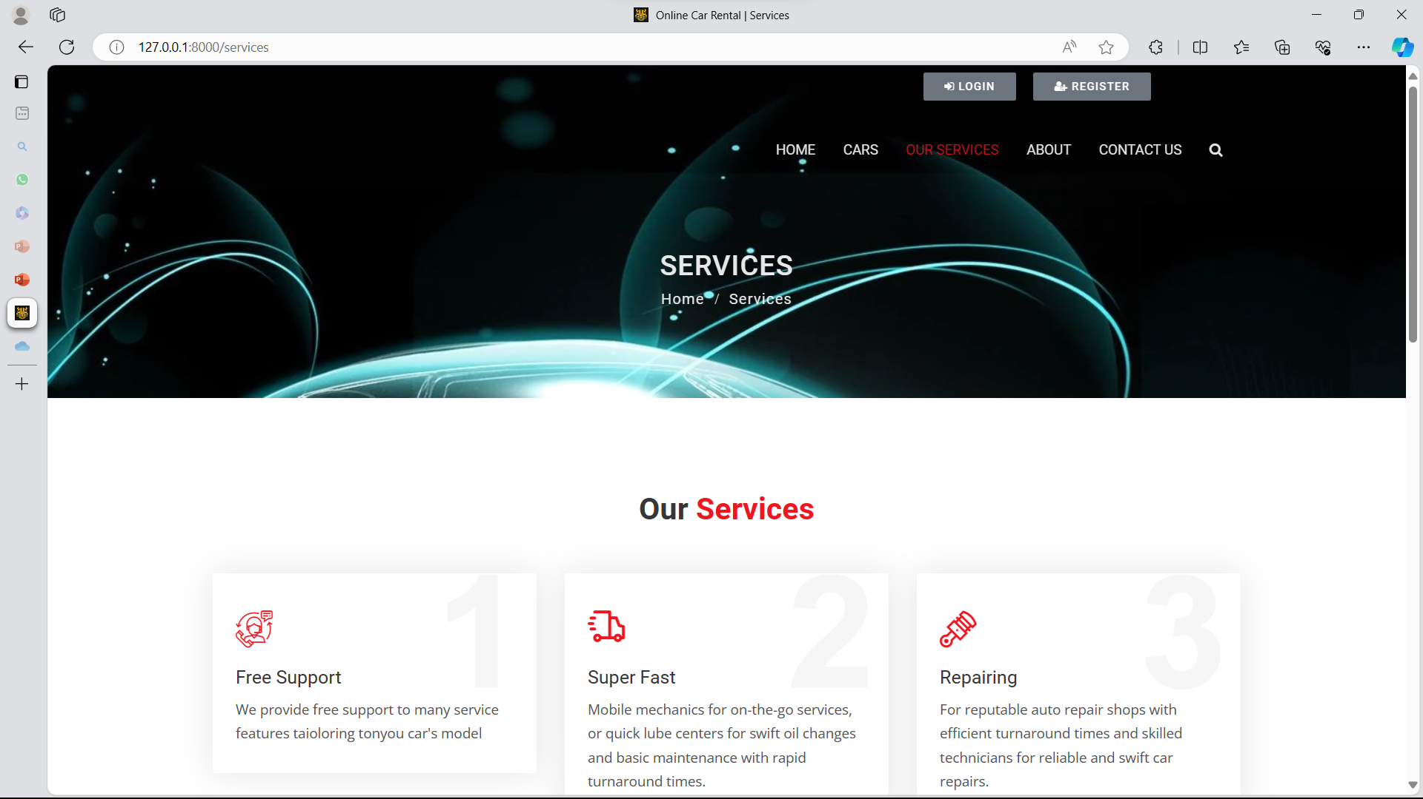
Service-Page

Slide 14
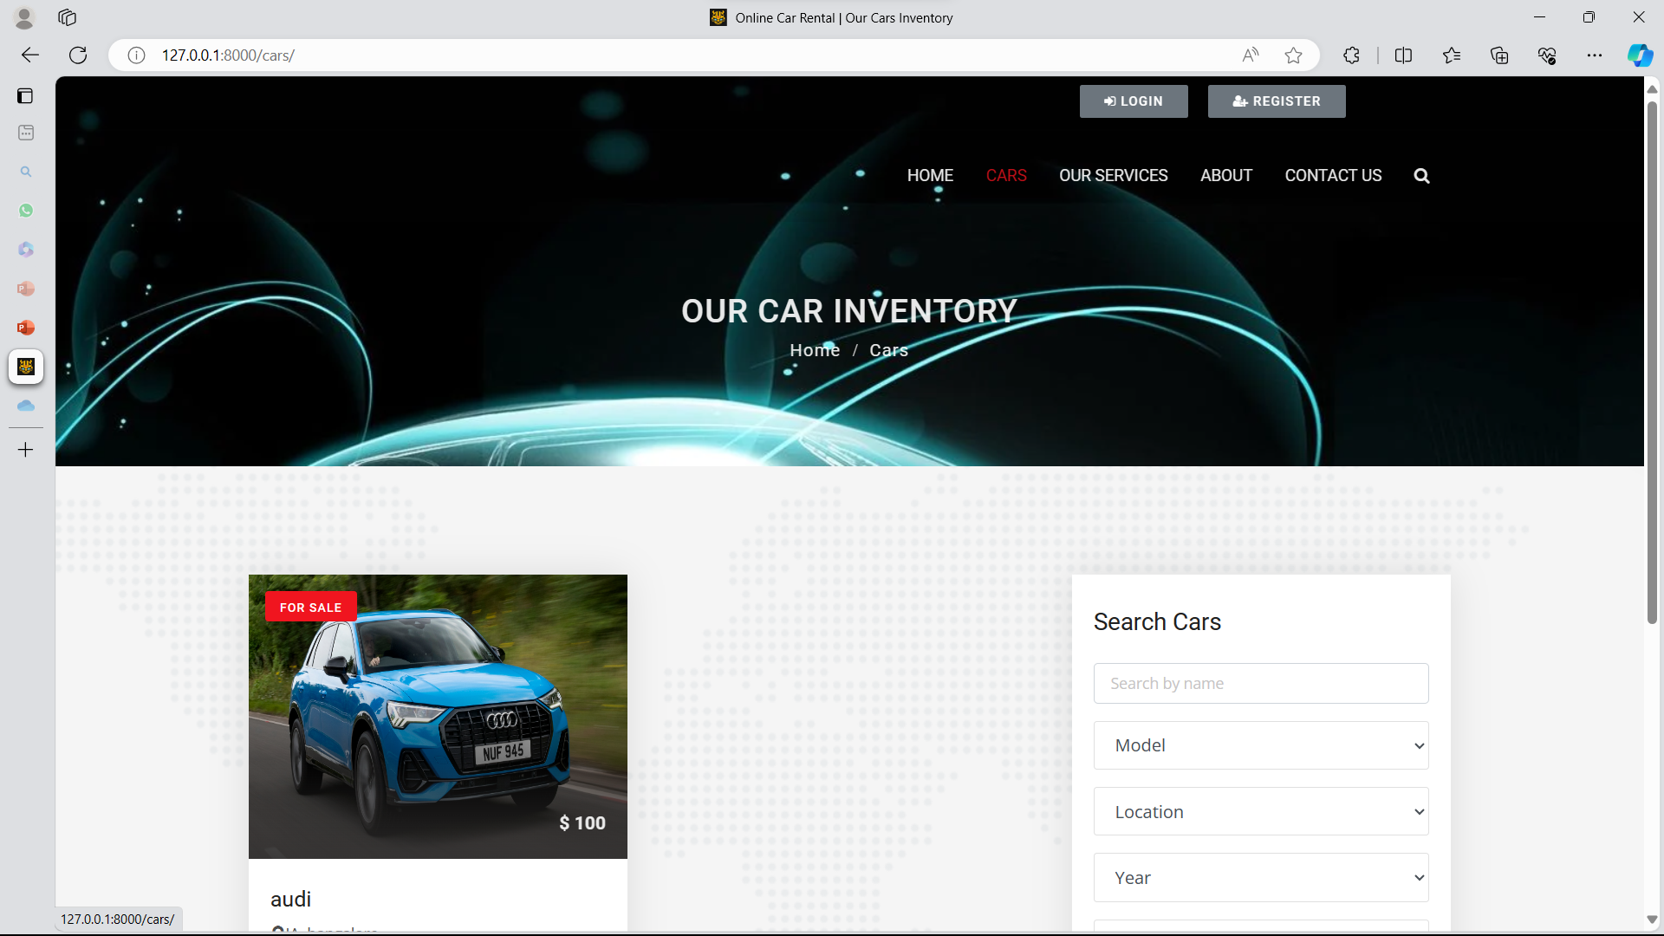
Cars-Page

Slide 15
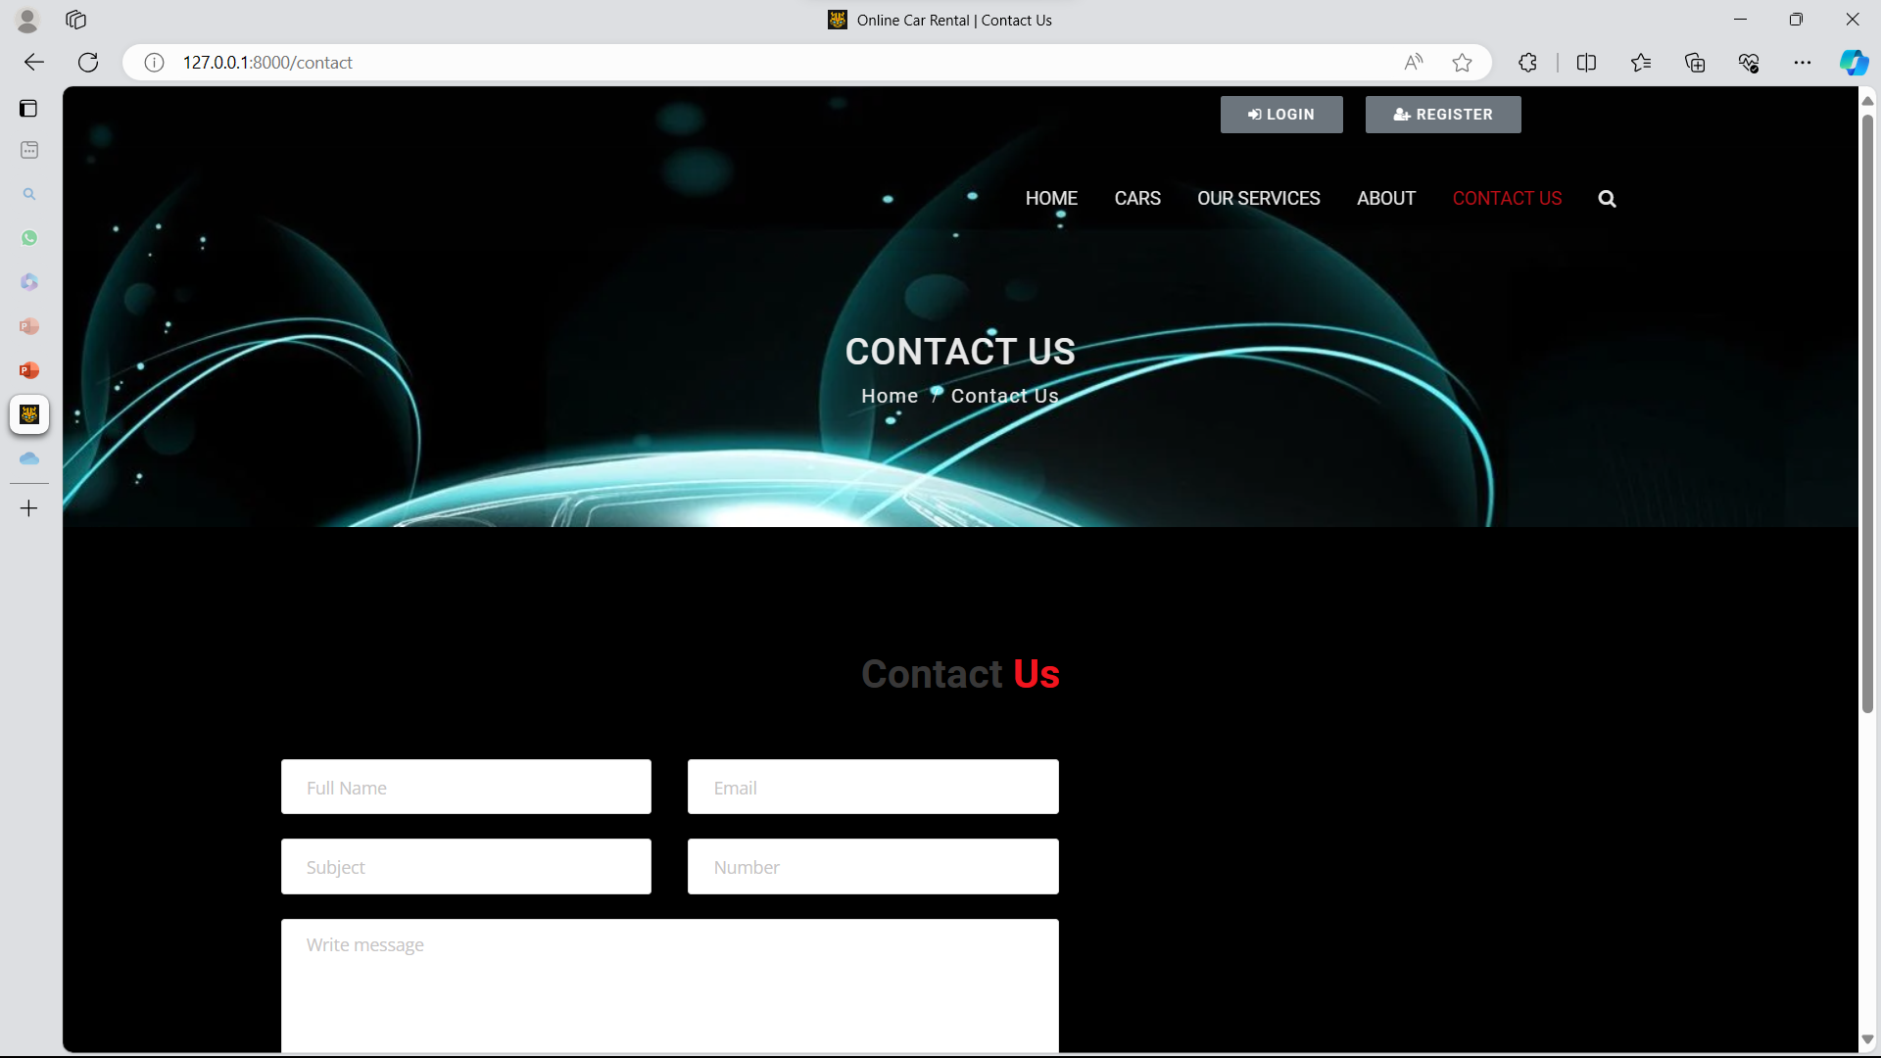
Contact-Page

Slide 16
Future Enhancements:
1.Mobile App Development: Expand the platform by developing dedicated mobile applications for both Android and iOS devices, offering users the convenience of renting cars on the go.
2. Integration of AI and ML: Implement artificial intelligence and machine learning algorthims to analyze user preferences and behaviour , providing personalized recommendations for car selections and improving the overall user experience.
3.Enhanced Fleet Management: Introduce advanced fleet management features for administrators, including predictive maintenance scheduling, real-time tracking of vehicle locations, and optimization of car allocation based on demand patterns.
4. Incorporation of IoT: Utilize Internet of Things (IoT) technology to equip rental cars with sensors for monitoring various parameters such as fuel levels, engine health, and vehicle diagnostics, enabling proactive maintenance and optimizing operational efficiency.
5.Expansion of Services: Diversify the services offered beyond traditional car rentals, such as incorporating options for car-sharing, ride-hailing partnerships, or integrating electric and hybrid vehicles into the fleet to cater to eco-conscious customers.

Slide 17
Conclusion
In conclusion, the car rental system project presents a comprehensive solution for facilitating smooth and efficient vehicle rentals. With a user-friendly interface allowing for easy browsing, booking, and management of reservations, coupled with robust backend functionalities for inventory management and administrative control, the system aims to streamline the rental process for both users and administrators. Future enhancements such as mobile app development, integration of AI and IoT technologies, and expansion of services offer promising avenues for further improving the system's functionality, user experience, and market competitiveness. Through rigorous testing, deployment, and ongoing refinement, the project endeavors to deliver a reliable, secure, and innovative platform that meets the evolving needs of the car rental industry and ensures customer satisfaction.
Source :

Slide 18
Thank You!
Notes:
Thank You !!

